Slide 1

Scaling to Enterprise DevOps
Eric Ledyard,
Principal Outbound Product Manager
Ben Riley
Advisory Solution Consultant

Slide 2

Agenda
Scaling DevOps
Customer Case Studies
Q&A
2
© 2020 ServiceNow, Inc. All Rights Reserved.
2

Slide 3
Business imperative for scaling DevOps to the Enterprise
Public Cloud usage is accelerating and new stacks are evolving
DevOps is strategic and the relationship with IT is evolving
Infrastructure as Code and infrastructure Automation
47%
80%
60%
IT spend allocated to Cloud in 2020 (up from 31% in 2017)
of IT organizations will adopt DevOps initiatives by 2021 (up from 41% in 2017)
Of organizations will use automated infrastructure tools as part of DevOps toolchains by 2023
Source: McKinsey, Gartner, Gartner
Notes:
By 2023, 60% of organizations will use infrastructure automation tools as part of their DevOps toolchains, improving application deployment efficiency by 25%.
Transformation is driving DevOps but organizations are struggling to scale DevOps and see value.
Small teams are making progress but the overall delivery lifecycles are not speeding up and reliability problems remain
There is often a mismatch in the needs of the enterprise and the operating model of individual teams
ServiceNow automates the Enterprise

Slide 4
Accelerating DevOps adoption and value
Many companies that have attempted DevOps have seen no increase in release frequency.
61% of developers spend less than 4 hours a day writing code¹
90%
of release problems have configuration errors as part of route cause
1. ActiveState – 2019 Developer Survey

Slide 5
Accelerating DevOps adoption and value
Many companies that have attempted DevOps have seen no increase in release frequency.
61% of developers spend less than 4 hours a day writing code¹
23+ Days to approve a change on average
90%
of release problems have configuration errors as part of route cause
There’s an explosion of configuration data and no standardized options for management
1. ActiveState – 2019 Developer Survey
Notes:
Deployment frequency and developers doing admin work is due to traditional approaches to processes like planning and change management
Release problems are due to the continuing complexity of releases and explosion of configuration data

Slide 6

Bringing ServiceNow and DevOps together
Speed
Visibility
Productivity
Deliver innovation faster without risks
Provides actionable insights across lifecycle
Empower teams and improve dev experience
Integrations
Integrate with all the tools
Initial Functionality
DevOps Change Automation
DevOps Insights
JIRA, GitHub, Jenkins Integrations
Notes:
High level approach to DevOps
Adjacency ITSM – change and release friction to delivering innovation fast
Adjacency ITOM – reduce MMTR

Slide 7
Connecting Dev to Ops in large organizations
Continuous
Compliance
Service Health
DevOps
Data Model
& CSDM
DevOps Insights &
Analytics
Agile Team Planning
Change Automation
Release
Readiness
Dev
Manage Configuration Data
Secure Configuration Data
Validate Configuration Data
Ops
Co-Operate, Co-Create, Co-Deliver
Discover App Teams
Measure performance
Automate Change
Visibility
Traceability
Compliance
Hybrid Operating Model
Notes:
Service Health:
Application service. Service Health use case
Paris App Service Creation API
DevOps change as probable cause of incident (investigation)

Slide 8
Potential benefits – annual savings per 100 developers*
Project execution
Reduce CAB meetings
Reporting and analytics
Developer productivity
Faster project execution due to higher productivity
$1.9M from delivering innovation sooner
80% reduction in development-related CAB meetings
$276k in time saved
20% reduction in report and dashboard creation effort
$232k in manual reporting savings
Give back 15 minutes per day, per developer
$600k in productivity savings
Other savings include: reduction in outage triage time, faster project execution, and an improved experience that increases retention
* = Example real-world customer use-case – results may vary
Notes:
Innovate quickly and safely: Project execution: (Large multi-national based on $2.9M for 150 developers)
Drive business value (efficiency): CAB Meetings: 80% reduction in CAB meetings (or elimination of need for meeting capacity to handle rate of change growth) related to development changes (Large multi-national based on $414k for 150 developers)
Pinpoint problems: Reporting and Analytics: Eliminate the manual work for bringing data together and creating reports (Large multi-national based on $348k for 150 developers)
Improve the developer experience: Developer productivity: E.g. 15 minutes per day at $100 per hour rate x 5 days per week x 48 weeks per year = $6k per developer. Time comes from creating change tickets, tacking part in change meetings, change audits etc. (Norwegian bank)

Slide 9
Use Cases

Slide 10
Deploy fast but safety
Automating governance to improve the developer experience

Slide 11
DNB – a digital bank
Apply and receive mortgages online in minutes
Do all your daily bank tasks online
Buy and sell shares and funds in our app
Chat with our chat bots at any time
Pay by debit or credit card and see your spending online immediately
24/7/365, via mobile phone or computer
The largest bank in the Nordics in 2019
Over 500 million Euro in annual IT cost
Some 1200 IT-employees
More than 800 external IT consultants
850 Business Applications
230 active IT projects
Notes:
Why the volume of IT solutions is increasing year by year.

Slide 12




What we knew when we started - Development
Reducing the cycle time from idea to implementation has lead to a cutting of curves
Large variation in kanban structure (status of ongoing work)
One pipeline tool set «per team»
No coordinated pipeline structure or policy set
Notes:
It’s easy to look blindly at the faults and malfunctions.
Each team its own structure – seemingly chaos
Quote from our chief architect: If there exists a tool on the market, we have it.
But: The deveoplers in DNB are the ones who are really creating value to the company. They are eager at enhancing usability and customer satisfaction. They will do what it takes to avoid wasted time and work.

Slide 13




What we knew when we started - Operations
Time consuming change ticket form
Long cycle time -weekly Change Advisory Board and Tech Advisory Board
Strict policies and little insight and knowledge
Long distance between approvers and developers
Notes:
So over to the gate keepers of the Operations in DNB: the change process. Also here there were quite a load of malfunctions.
Change tickets took about 20 minutes to create each – if you were lucky
All changes had to og via a weekly CAB (Change Advisory Board), some even a TAB (Tech Advisory Board)
The change ticket had to be correctly filled in, a distant change manager without knowledge about you work methods or ethics could reject the change and you would have to start over and wait for next week’s meeting.
Little knowledge on the technology stack and development methods, rejects were based on «policies»
But: since the change regime did a reentry with Servicenow two years ago, the amount of red days is reduced greatly. And the awareness of risk has risen accordingly. So they have created value to the organisation.

Slide 14

Automation of all change tickets if
Your CI/CD pipeline tool is accepted by DNB and the deployment process is at least partially automated
You have a minimum set of mandatory data in your pipeline tools needed for the change ticket to be auto approved
You have a set pipeline that separates environments used for Production, UAT, System testing and Development.
You allways run the different tests in dedicated environments
All tests run successfully
You have defined a schedule stating when you are allowed to deploy to production
You have no open critical or major incidents on your service
Alimantarium.org
Notes:
We can do things the quick and safe way. It’s simply a trade off between individual uniquness and a certain uniformity designed to fit DevOps best practises.

Slide 15
The overall business case
We have estimated a 20 minutes’ reduction per change ticket.
For the first dev team of 6 deploying 2 increments each per day: 2 hours saved per day, or 10 hours per week
The next team of 20 has not been compliant to DNB policies, but will still save around 2 hours per day/ 10 per week
The yearly amount of capital bindings we may reinvest in more lucrative ways is confidential, but let’s say it is a far better business case than the saved hours.
From September 2020 it is decided that this will be the preferred solution for devops change handling in DNB.

Slide 16
Eliminate configuration change outages
Centralizing configuration management

Slide 17
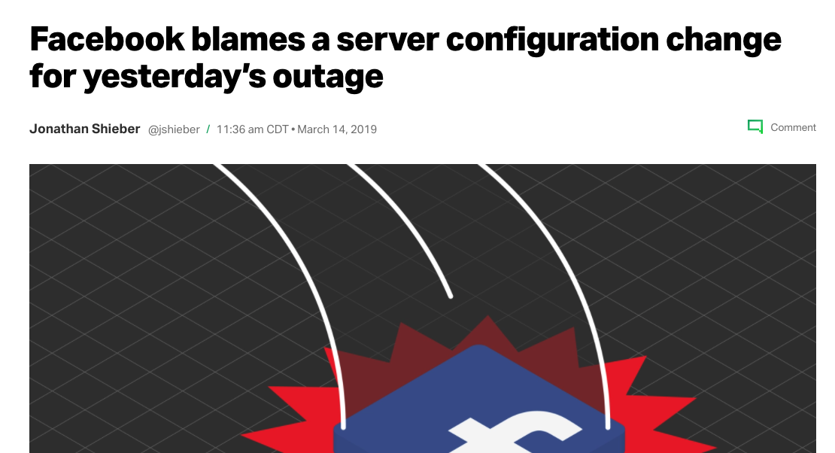
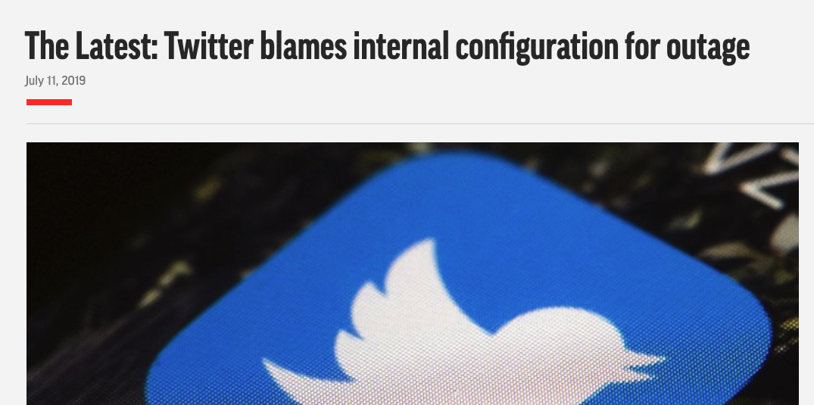
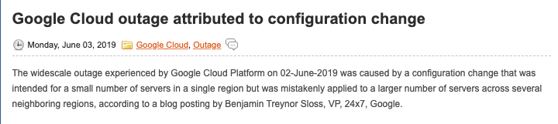
Configuration outages are still happening
A significant proportion of outages are driven by configuration changes
Impacts Satisfaction, revenue and expense
~60% of incidents are not detected before end-user impact¹
79% have major incident MTTR greater than 3 hours¹
¹ IDC
Bottom line – there remains an urgent need to prevent outages!

Slide 18
Telecommunications – validation and discovery
Data center (ESX – 60,000 VMs) - Business continuity & operational resilience
Challenge:
3 principle CMDB’s in use for 2 datacenters DC
Many duplicated resources in each of the CMDBs
Data is inconsistent, conflicting, 1 CMDB has more data than the others, missing data
Resulting in lack of “the source of truth”
Manual work to sync CMDBs, takes time and is “too little too late”
Hard to measure compliancy to contracts/SLA’s & risk
Unable to map and use the discovered data (e.g. real server config) to the sources of truth.
Inconsistent data
No source of truth
Lack of compliance

Slide 19
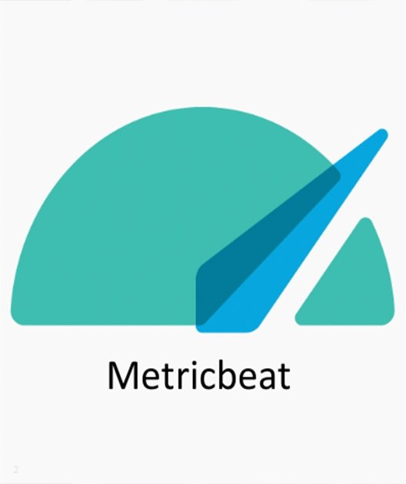
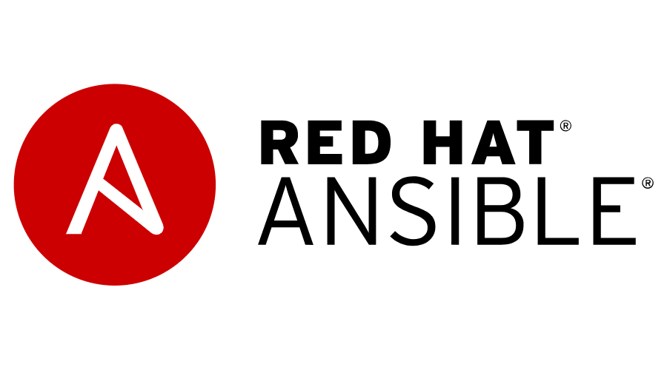




Telecommunications – validation and discovery
Data center (ESX – 60,000 VMs) - Business continuity & operational resilience
Solution:
Correlates and continuously validate the discovered data with the stored data in each of the 3 CMDBs​
Creates synchronization scripts which trigger workflows to correct/repair/complete/enrich the config data
Machine Learning accelerated root cause analysis to shorten time between detection and remediation
Reduced people’s workloads
Improved decision-making
Avoid SLA breaches and penalties
Key integrations

Slide 20
Financial Services – application release pipeline
Trade management application – transitioning to automated release pipelines
Challenge:
Very broad application technology spectrum
Transitioning from manual to automated deployments
Current practices require human interactions and are subject to costly mistakes
200 applications being manually managed by small teams of expert users
Many different tools and methods in use contributing to downtime, rework and poor customer experience
Development configurations were making it into production
Slow and manual processes
Poor customer experience
Security and related issues from development configs in production

Slide 21



Financial Services – application release pipeline
Trade management application – transitioning to automated release pipelines
Solution:
Central agnostic repository for all configuration data
Consistent along every stage of the release pipeline
Collects, consolidates, validates and serves the configuration data to the Continuous Delivery (CD) tools
Enables CD workflows
Reduced application downtime and costs
Scale team impact without having to add resources
Improved standardization
Key integrations

Slide 22

Q&A
Thank you for joining us, please visit our booth!
Eric Ledyard
Principal Outbound Product Manager
Ben Riley
Advisory Solution Consultant
servicenow.com/products/devops.html
22
© 2020 ServiceNow, Inc. All Rights Reserved.

Slide 23
Backup

Slide 24
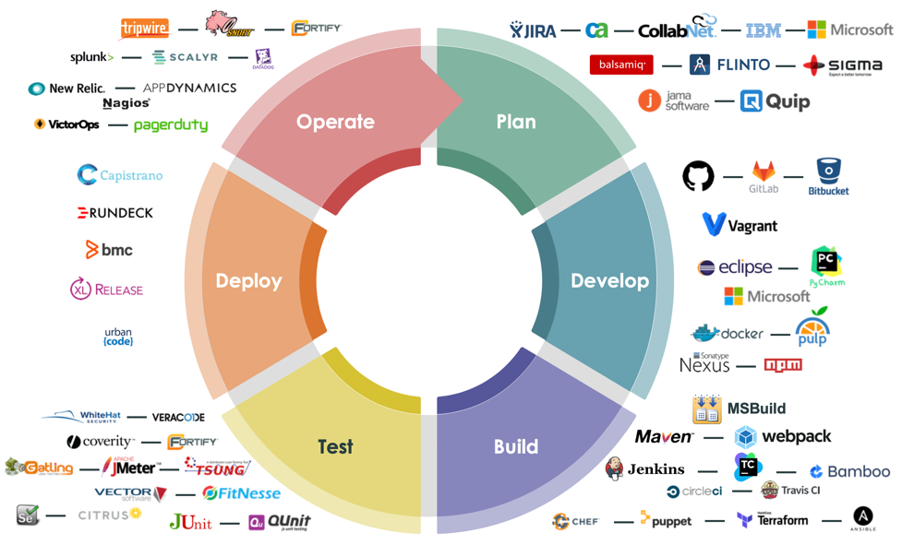
ServiceNow DevOps - Leveraging the Platform
Taking the tried and tested approvals process and adapting it to DevOps
Taking the ServiceNow CMDB to be single repository to manage all configuration data
Risk assessed
Impact understood
Build successful
Unit tests passed
Test coverage >80%
Security tests passed
Discover and Collect
Secure and govern
Version and audit
Test and validate
Distribute to consumers
Auto Approve
Auto Config Data Management
Notes:
Toolchains are complex and varied but it’s expensive in terms of development down time to force everyone into a single toolchain. The answer is to use what you already have and adjust over time.
We connect key DevOps tools you already use – providing out of the box integrations ranging from the planning tools like Jira or ServiceNow ITBM, through the code repositories like GitHub and BitBucket to the pipeline tools like Jenkins
We utilize information from that toolchain to automate the creation of a change request in ServiceNow – initiating the assurance path without requiring developers to ‘swivel-chair’ – they don’t have to enter anything in ServiceNow
This alone has implications of major savings in developer productivity
We can also use Change Management policies to automate the change approval process. A risk- and fact-based assessment can ensure the safe, automatic approval of a large proportion of changes
The data gathered allows for new, insights across multiple teams and DevOps toolchains. A key use of this data is for auditing which becomes a ‘one-button’ action linking all the way from ideation to production instead of a manual integration and data-gathering process that can take multiple person-weeks of effort.

Slide 25



























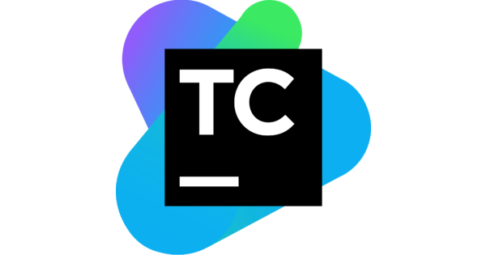
ServiceNow Enterprise DevOps Platform
Plan
Develop
Build
Test
Deploy
Operate
Knowledge Mgmt
Notify
Push
Mobile
Actionable Analytics
Guided
Tours
Supervised Machine Learning
Anomaly Detection
Time
Series Database
Peer Benchmarking
Virtual Agent
Service
Portal
Flow Designer
Integration Hub
Orchestration
Service Graph
Service
Catalog
Visual
Task
Board
Connect
Workflow
Enterprise DevOps Platform
Configuration Data Management
Agile Planning
Source Code
Build Tools
Testing and
Quality
Deployment
Operations
ITSM
ITSM/ITOM
ITBM
Notes:
Our company tagline is: “We make the world of work, work better for people.”
That tagline can be said in the following way for DevOps: “We make the world of DevOps work better for people.” Since, after all, DevOps is just another piece of work in an organization. There is a requestor (App Owner) and a provider (Dev and Ops) and a workflow process in-between.
Our power comes from being able to tie that entire DevOps toolchain together and provide a higher level of analytics, collaboration, Machine Learning, and Intelligent Action across tools that traditionally do not have integrations with one another.

Slide 26
ServiceNow connects Dev to Ops
Continuous
Compliance
Service Health
DevOps
Data Model
& CSDM
DevOps Insights &
Analytics
Agile Team Planning
Change Automation
Release
Readiness
Dev
Manage Configuration Data
Secure Configuration Data
Validate Configuration Data
Ops
Co-Operate, Co-Create, Co-Deliver
Discover App Teams
Measure performance
Automate Change
Visibility
Traceability
Compliance
Hybrid Operating Model
Notes:
Service Health:
Application service. Service Health use case
Paris App Service Creation API
DevOps change as probable cause of incident (investigation)

Slide 27
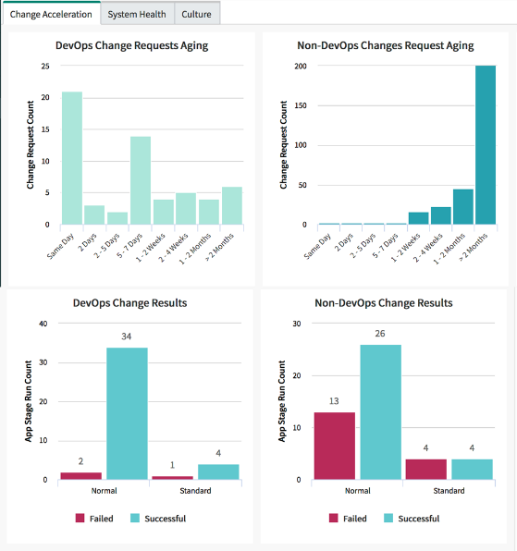




ServiceNow DevOps Process Enhancements
Connect to CI/CD toolchain
Automate Change Management
Share insights
Auto Create Request
Risk assessed
Impact understood
Build successful
Unit tests passed
Test coverage >80%
Security tests passed
Auto Approve
Key Integrations:
Days/weeks to minutes with automated change approval, chain of custody audit transparency
Notes:
Toolchains are complex and varied but it’s expensive in terms of development down time to force everyone into a single toolchain. The answer is to use what you already have and adjust over time.
We connect key DevOps tools you already use – providing out of the box integrations ranging from the planning tools like Jira or ServiceNow ITBM, through the code repositories like GitHub and BitBucket to the pipeline tools like Jenkins
We utilize information from that toolchain to automate the creation of a change request in ServiceNow – initiating the assurance path without requiring developers to ‘swivel-chair’ – they don’t have to enter anything in ServiceNow
This alone has implications of major savings in developer productivity
We can also use Change Management policies to automate the change approval process. A risk- and fact-based assessment can ensure the safe, automatic approval of a large proportion of changes
The data gathered allows for new, insights across multiple teams and DevOps toolchains. A key use of this data is for auditing which becomes a ‘one-button’ action linking all the way from ideation to production instead of a manual integration and data-gathering process that can take multiple person-weeks of effort.

Slide 28









Explosion of configuration data
90% of release problems state configuration data is often the cause of release failures
code
configData
?
DEV
Go-live
Notes:
Impact
Security audit failure
Incomplete automation of CI/CD pipeline
Slower problem resolution resulting in poor user experience

Slide 29
ServiceNow Sweagle Configuration Data Management
One platform and one process for all configuration data
code
configData
Sweagle Configuration Data Management
DEV
Go-live
ServiceNow CMDB
Notes:
Impact
Security audit failure
Incomplete automation of CI/CD pipeline
Slower problem resolution resulting in poor user experience

Slide 30



Business Value
Delivery Process Improvement
Configuration Management
PRODUCTIVITY
Eliminating administrative work and providing easy access to end-to-end perspectives
Automating and simplifying the management of configuration items, improve environments SLAs
COMPLIANCE
Seamless change process and potential integration with Integrated Risk Management
Ensure secure and compliant access to configurations
COST REDUCTION
Change request throughput and developer productivity plus one-touch audit
Higher standardization, incident avoidance, and eliminating rework
Notes:
BVA/Levers

Slide 31

Value Levers
There are 4 main value levers that we have been using to help customers justify their DevOps spend:
(Change) Automation
Push-Button Audit
Visibility and Traceability
Time to Market
We estimate customers will return 14% of their teams’ time by automating change.
This is roughly $1.5M for every 100 people they onboard.
We estimate that customer will save 3 FTE weeks of equivalent time per audit request.
JPMC captured $3.6M in savings from the push-button audit for the first 30 teams they onboarded.
This is harder to quantify in spend but based in reducing manual meetings and data gathering/reporting.
The value is that this was previously not possible at all. Now, you can get insights across all your toolchains.
Top-Line Revenue Generation! Get to market faster.
Quantify by figuring out the cost of delay and magnify that by automation savings and increased throughput.

Slide 32
XXXXX can realize benefit of $4.4M over 5 years
5 Year Benefit Summary
Developer Productivity
Change Productivity
Project Execution
Summarized Value Metrics
$656K
2% higher productivity with less support for changes and audit
$414K
80% reduction in development CAB’s meetings
$2.9M
Faster project execution due to higher developer productivity
405%
ROI
5 months
Payback Period
Service Outages
Reporting & Analytics
$3.6M
5 Year Net Benefit
$38K
20% reduction in outage triage time with better change process adherence
$348K
20% reduction in report and dashboard creation effort
$59K
Cost of Delay / month
Key highlights
Accelerated implementation timeline due to XXXX's current use of and familiarity with ServiceNow's platform
Current benefits covers only 150/500 developers and expanding use of solution to more developers will deliver more benefits as adoption grows
Benefits ramp up after implementation (50%, 75% and 100%) over 3 years

Slide 33

ServiceNow DevOps value
Reduce OPEX/
CAPEX
3X
20%
$7M
more changes approved in the first nine months¹
Time savings with elimination of manual changes and manual re-work¹
In cost savings for the first 30 DevOps teams onboarded¹
50
3 FTE
$3.6M
hours per month saved per dev team by automating change and config²
addition avoided while increasing release frequency²
In cost savings by automating audit data collection¹
Top Line Revenue
1. Mix of actual and expected results from two financial services companies 2. Expected savings for a geographic information systems company
Notes:
[You may wish to adjust which circles are used in a presentation depending on those that are most applicable]

Slide 34
Thank you

